Slide 1
Avara Search (Cost)
Group 3

Slide 2
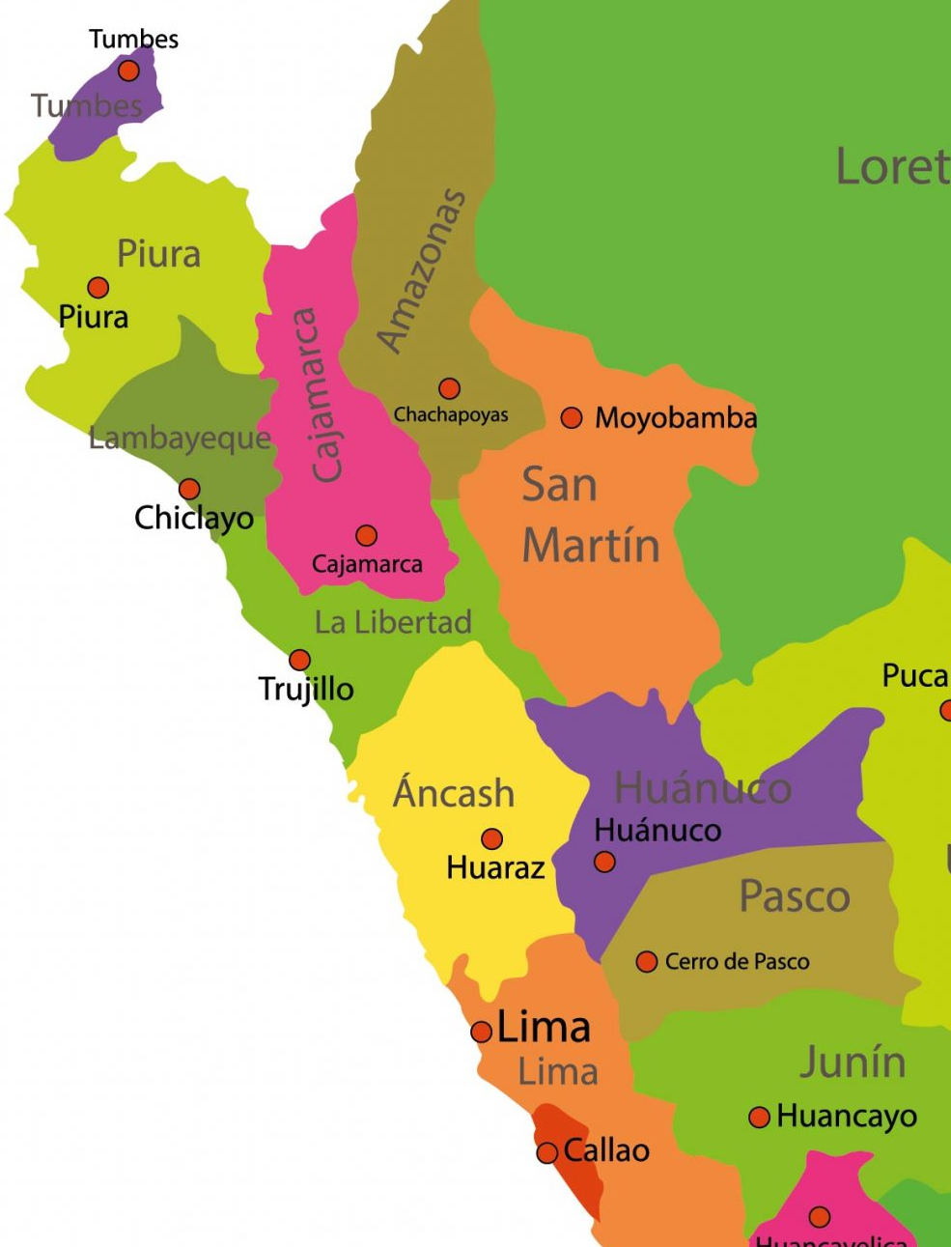
AVARA SEARCH (prioritizing cost)
Department (Capital) | Cost (in soles) of the bus ticket from Callao to:
Chiclayo | 130
Cajamarca | 140
Chachapoyas | 240
Trujillo | 135
Huaraz | 70
Huánuco | 65
Lima Norte | 12
Callao | 0
50
75
60
40
45
90
70
20
50
45
12

Slide 3
Getting from Chachapoyas to Callao, at the lowest possible cost
Chachapoyas
Cajamarca
Chiclayo
c=140
c=130
Trujillo
Cajamarca
Chachapoyas
c=135
c=140
c=240
Chiclayo
Cajamarca
Huaraz
c=130
c=140
c=70
Trujillo
Trujillo
Huánuco
Lima Norte
h=31
Cajamarca
c=160
c=140
c=65
c=12
Huaraz
Callao
c=70
Huánuco
c=0
c=65

Slide 4
SOLUTION The idea of applying the algorithm of "Avara Search" was raised, since it is a quick solution, for this a function called heuristic is used which "estimates" cost (economic) that implies reaching Chachapoyas from Callao
Optimal route: Chachapoyas – Chiclayo – Trujillo – Huaraz - Lima Norte - Callao
Cost(Economic): 50 + 40 + 70 + 50 + 12 + 0 = 222 soles

Slide 5
Avara Search (time)
Grupo 3

Slide 6
AVARA SEARCH (prioritizing time)
Department (Capital) | Time (in hours) of the distance in a straight line from Callao to:
Chiclayo | 40
Cajamarca | 37
Chachapoyas | 43
Trujillo | 31
Huaraz | 16
Huánuco | 18
Lima | 1
Callao | 0
18
19
5
4
6
19
18
8
15
26
0.4

Slide 7
Getting from Chachapoyas to Callao, in the shortest possible time
Chachapoyas
Chiclayo
Cajamarca
h=40
h=37
Chachapoyas
Trujillo
Huaraz
h=43
Chiclayo
h=40
h=31
h=16
Cajamarca
Lima
Huánuco
Trujillo
Trujillo
h=37
h=1
h=18
h=31
h=31
Callao
Huánuco
Huaraz
h=0
h=18
h=16

Slide 8
SOLUTION As with the cost, the algorithm of "Avara or Voraz Search" was proposed, since it is an effective solution, for this the heuristic was used which "estimates" cost (time) that implied reaching Chachapoyas from Callao
Optimal route: Chachapoyas – Cajamarca – Huaraz – Lima - Callao
Cost(Time): 19 + 19 + 15 + 0.4 = 53.4 horas

